Slide 1
CS5100 Final Project Analysis of the Enron Fraud Scandal and Fraud Detection using Classification Algorithms
Anwesa Basu, Swapnendu Majumdar
12/15/2022

Slide 2
Agenda
Introduction
Background Context
Approach
Observation and Results
Conclusion

Slide 3
Introduction
This project is designed to investigate the Enron corporate scandal.
We are analyzing the Enron Fraud Dataset to identify the person of interest (POI), publicly available on Kaggle.
To perform our analysis, we implemented untuned classification algorithms and then further tuned some of them to improve their performance.
Finally, we documented the results of these algorithms, and performed a comparative analysis of the different algorithms used in the scenario.

Slide 4

Background Context
In the year 2000, Enron was one of the largest companies in the United States. By 2002, it had collapsed into bankruptcy due to widespread corporate fraud. In the resulting Federal investigation, a significant amount of typically confidential information entered into the public record, including tens of thousands of emails and detailed financial data for top executives. We have investigated the Enron corporate scandal by analyzing the Enron Email Dataset and used different classification algorithms to identify the persons of interest (POI), who have been involved in fraudulent activities.

Slide 5
Approach
Data Cleaning
Missing Data Handling
Outlier Removal
Feature Selection
Selecting Initial Features
Feature Engineering
selectKBest
Running Classification Algorithms
Training
Tuning
Testing

Slide 6
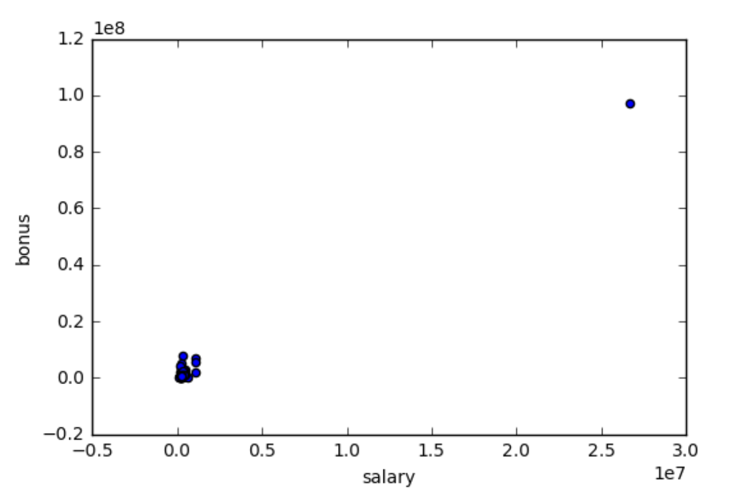
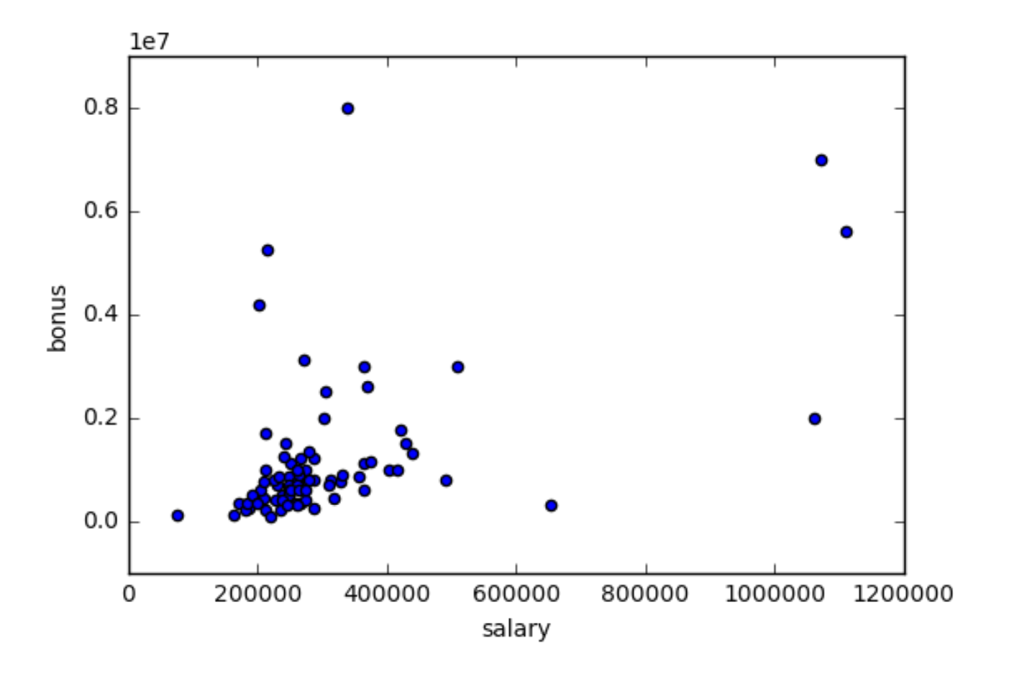
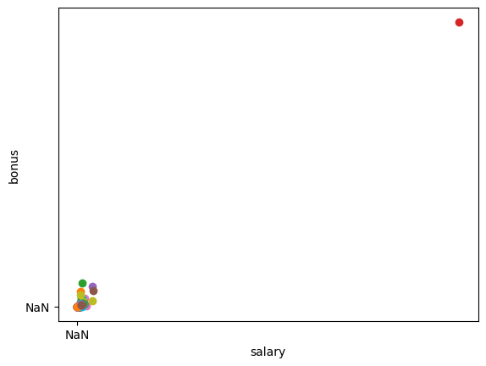
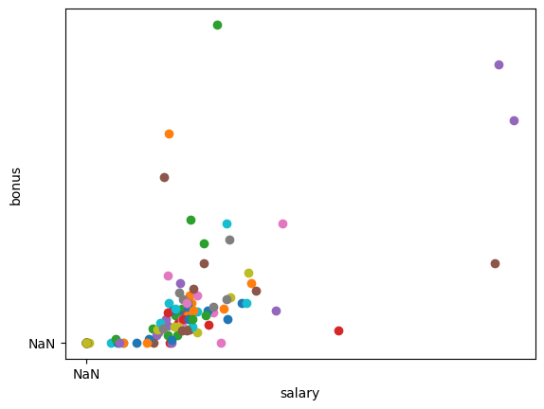
Data Cleaning
Removed Missing and Dirty Data from Dataset
Stored resulting dataset in a pickle file
Plotting graphs to observe and find outliers
Deleting outliers
Sample scatter plots of the data before and after the removal of outliers

Slide 7
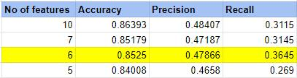
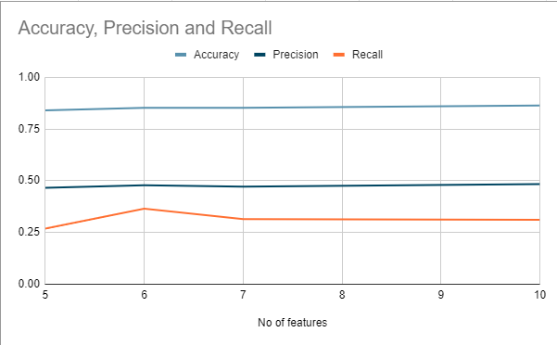
Feature Selection
Choosing initial features
Engineering new features and scaling. We engineered 3 new features in our implementation
Using selectKBest to choose K best features according to their f-scores
According to Bias-Variance tradeoff, too many features increase the variance, and therefore complexity, while too less features leads the model to become biased

Slide 8
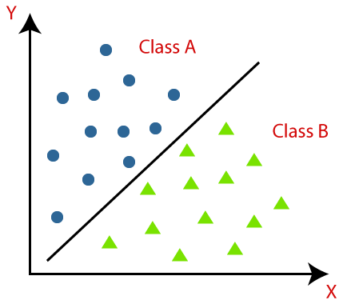
Classification Algorithms
Classification algorithm is a Supervised Learning technique that is used to identify the category of new observations on the basis of training data.
In Classification, a program learns from the given dataset or observations and then classifies new observation into a number of classes or groups.
Some of the classification algorithms that we have used in this project, to detect a Person of Interest (POI) are -
Gaussian Naïve Bayes
Decision Tree
AdaBoost
k-nearest neighbors
Nearest Centroid
Random Forest

Slide 9
Model Training
Initially the dataset is randomly split into two datasets in a ratio of 70:30.
The first resulting data set is used to train the classification algorithm, while the remaining data set is set to be used for testing.
Training allows the classification algorithm to learn from the input training data for the purpose of predicting the likelihood or probability that the data that follows will fall into one of the predetermined categories
It is important to train a model on the correct amount and quality of data as incorrect volume of data and/or inaccurate data might lead to the introduction of an overfitting bias.

Slide 10
Model Tuning
Tuning a model can help further improve the performance of an algorithm.
It involves repeatedly modifying the values of several hyperparameters and comparing the results with previous results, in order to determine the set of parameters leading to the most accurate model.
In our project, we achieved improved performance of two previously untuned models (namely Gaussian Naïve Bayes and AdaBoost) by tuning.

Slide 11
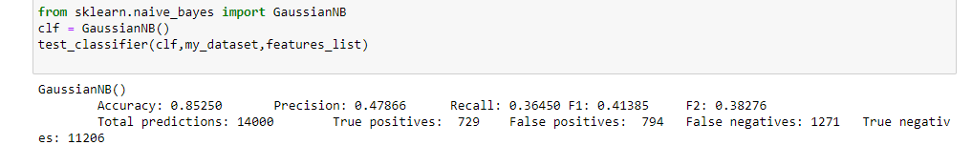
Model Testing
Testing an existing model is important to be able check the performance of the trained model on the testing dataset.
It allows us to check the success of our model while also measuring various metrics such as accuracy, precision and recall.
Depending on the results of the test, one might tune the model or re-train it altogether, for better performance.
An example of testing the untuned Gaussian Naïve Bayes Classifier

Slide 12
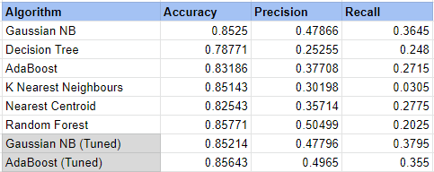
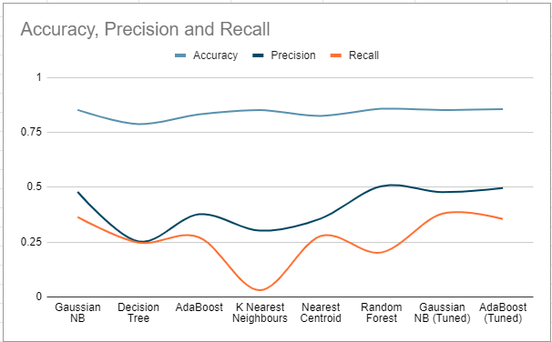
Observation & Results

Slide 13
Conclusion
From this analysis we can conclude that by and large most of the classification algorithms perform equally well on this dataset, with some minor differences in performance metrics. We could also see how tuning the classifiers improved the performance of the algorithms. Among the untuned classifiers, we could see that the Random Forest Classifier had the best metrics, while tuning the AdaBoost Classifier in particular made it perform really well too. The algorithms used in this project can similarly be used to perform other classifications too.

